Slide 1

نمایش ساختار مولکولی داروها در شبکه های عصبی گرافی
افروز راشدی
دانشجوی ارشد هوش مصنوعی

Slide 2
Representing Molecular Structure of Drugs in Graph Neural Networks
Afrooz Rashedi
MSc. AI Student

Slide 3
Table of Contents
Drug Structure
Introduction to SMILES
SMILES Notation Rules
Canonical SMILES
Canonical SMILES Algorithm
Cangen Algorithm
Cangen Example
Related Contents

Slide 4
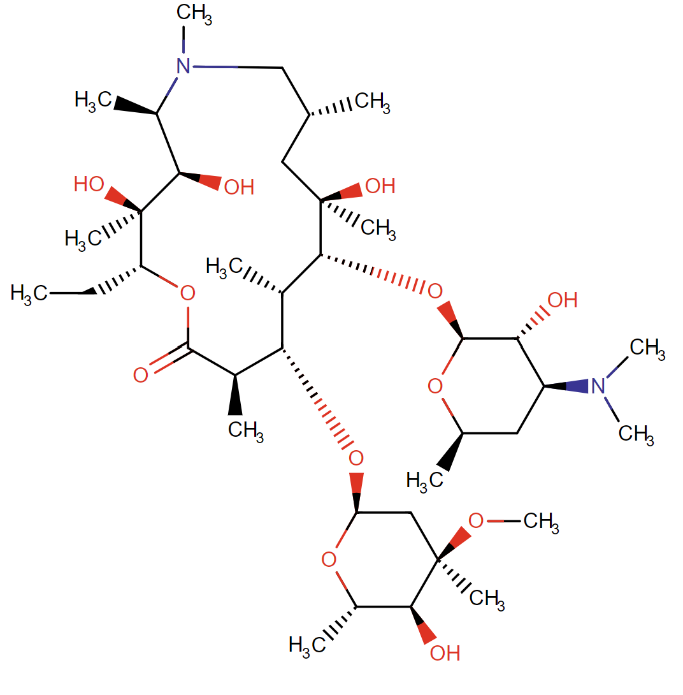
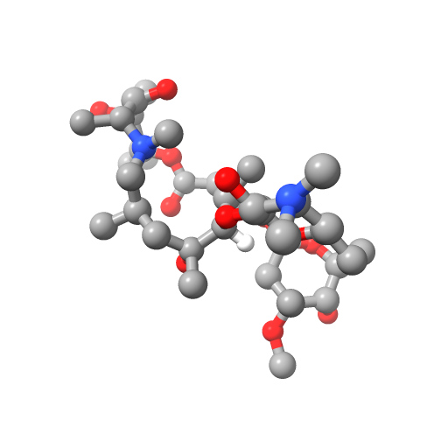
Drug Structure

Slide 5
What is SMILES?
Simplified Molecular Input Line Entry System
Translate a chemical’s 3-dimensional structure into a string of symbols
Simplicity and Readability to the human eye

Slide 6
SMILES Notation
Non-Hydrogen atoms represented by their atomic symbols
Any unfulfilled valency of an atom is assumed to be Hydrogen
Example:
Writing a simple C means a CH₄ (Methane)
A simple N is NH₃ (Ammonia)
A simple O is H₂O (Water)
Representing elemental atoms by []
[C] is elemental Carbon

Slide 7
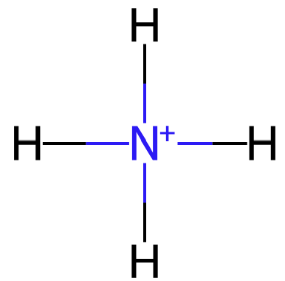
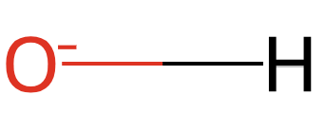
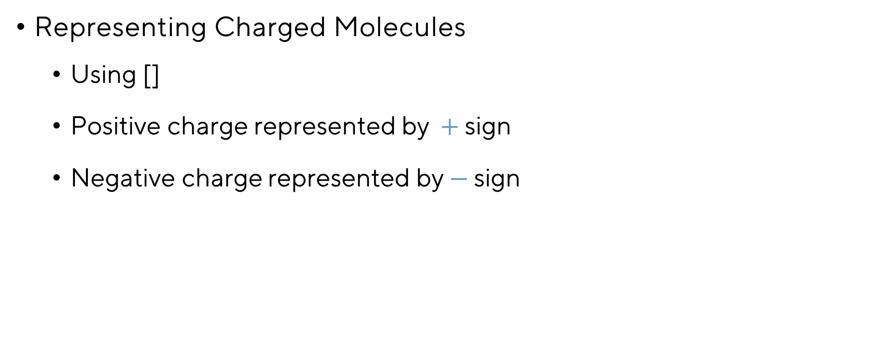
SMILES Notation
Ammonium Cation
[NH4+]
Hydroxyl Anion
[OH-]
Representing Charged Molecules
Using []
Positive charge represented by $+$ sign
Negative charge represented by $−$ sign

Slide 8
SMILES Notation
Representing Bonds
Single -
Double =
Triple #
Aromatic :
Single and Aromatic bonds are often omitted for simplicity
Adjacent atoms assumed to be connected by a single or aromatic bond

Slide 9

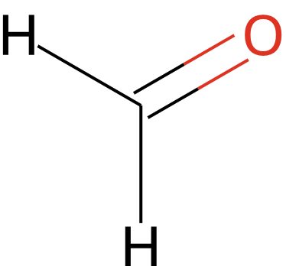
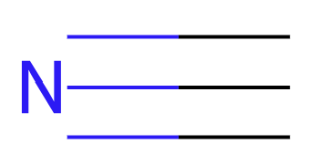
SMILES Notation
Representing Bonds (Examples)
Carbon dioxide (CO₂) O=C=O
Formaldehyde (CH₂O) C=O
hydrogen cyanide (HCN) C#N

Slide 10
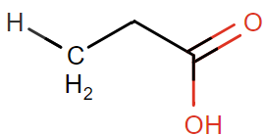
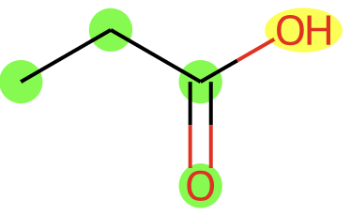
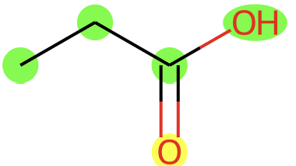
SMILES Notation
Representing Branches
specified by enclosures in parentheses
Propanoic acid C₃H₆O₂
Green highlighted atoms are taken as base chain
Yellow highlighted atoms are branch
CCC(=O)O CCC(O)=O

Slide 11
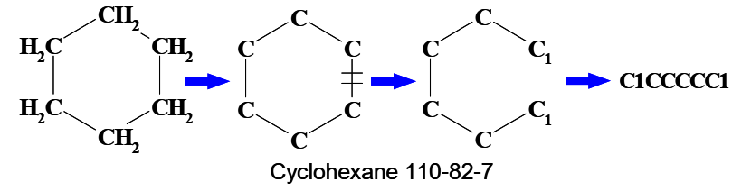
SMILES Notation
Representing Cyclic Structures
Break one single or double (aromatic) bond in each ring
Bonds are numbered in any order, designating ring-opening/closure bonds by a digit immediately following the atomic symbol at each ring closure

Slide 12
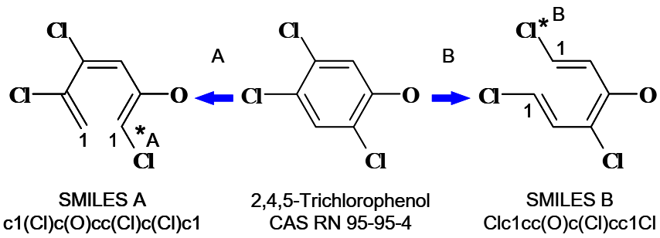
SMILES Notation
Representing Cyclic Structures
Different SMILES notations for the same structure
Breaking a ring in different places

Slide 13
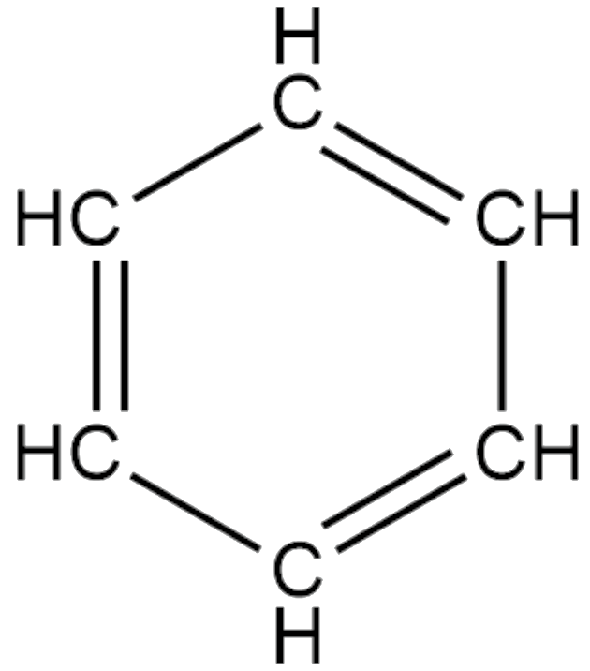
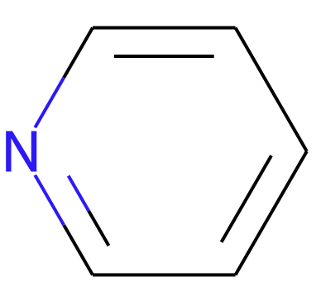
SMILES Notation
Aromatic Rings
Lowercase letters tells us this is an aromatic ring signifying alternate single and double bonds
Benzene (C₆H₆) Pyridine
c1ccccc1 c1ccncc1

Slide 14
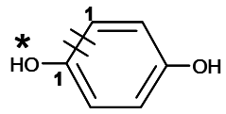
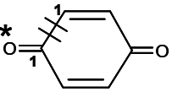
SMILES Notation
Nonaromatic Rings
Non-aromatic: indicated by UPPER CASE
Hydroquinone aromatic O=c1ccc(O)cc1
Quinone non-aromatic O=C1C=CC(=O)C=C1

Slide 15
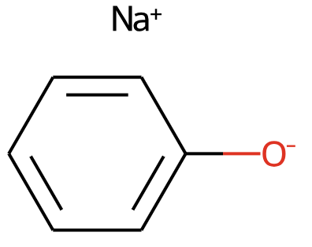

SMILES Notation
Disconnected Structures
Ions are not connected by a covalent bond
Disconnected compounds are separated by a “.”
Sodium Chloride Sodium Phenoxide
[Na+].[Cl-] [Na+].[O-]c1ccccc1

Slide 16
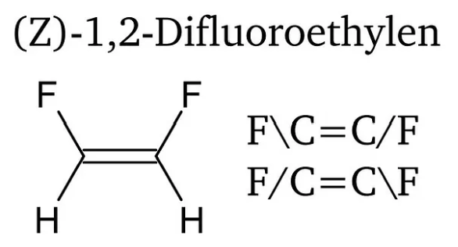
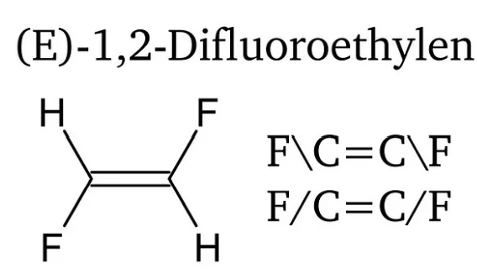
SMILES Notation
Isotopic Specification
The double bond configuration is indicated by placing ‘/’ or ‘\’ between the atom constituting the double bond and their subsequent bonding partners.

Slide 17
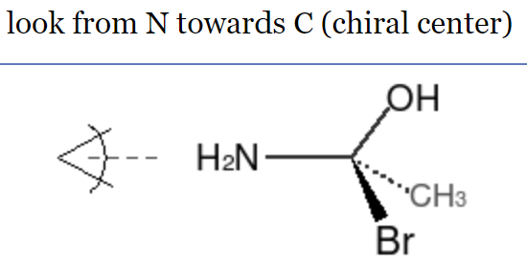
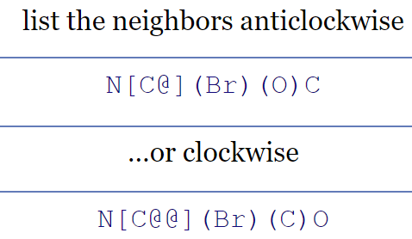
SMILES Notation
Tetrahedral Centers
anticlockwise, an ‘@’ is inserted after the central C-atom in []
For a clockwise order, ‘@@’ is inserted after the central C-atom in []

Slide 18
Disadvantages of SMILES string
SMILES is not unique
Doesn’t provide information about positions of each atom in space

Slide 19
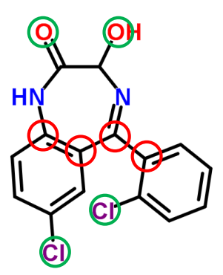
Canonical SMILES
Absolute or Unique SMILES
Easy identification of identical molecules
Solves “graph isomorphism” problem
Cangen Algorithm
A practical, efficient algorithm for generating canonical SMILES

Slide 20
Canonical SMILES Algorithm
Calculating the initial ranks of atoms:
Number of connections
Number of non-H bond orders
Atomic number
Sign of charge: 0 for non-negative, 1 for negative charge
Formal charge
Number of attached hydrogens
Isotope mass number

Slide 21
Cangen Algorithm
Improved invariants
“Stable” prioritization
Avoids ambiguities from combining invariants
Resolves “symmetric” atoms

Slide 22
Cangen Initial Invariants
Initial invariants encode atom type information
Number of neighbors
Sum of bond orders
Charge
Number of attached hydrogens
Initial invariants are transformed to ranks

Slide 23
Cangen Update Rule for Invariants
Rank is mapped to corresponding prime (Carbon)
New invariant:
primes of neighbors are multiplied
New ranks are determined based on:
Old ranks
New invariants

Slide 24
Cangen Iteration
Repeat until ranking is stable
Calculate new invariants
Re-rank atoms
Final ranking yields priorities
Generate Smiles

Slide 25
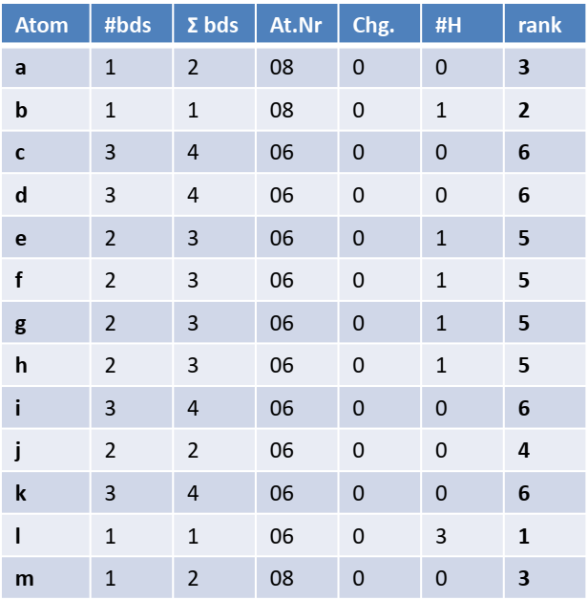
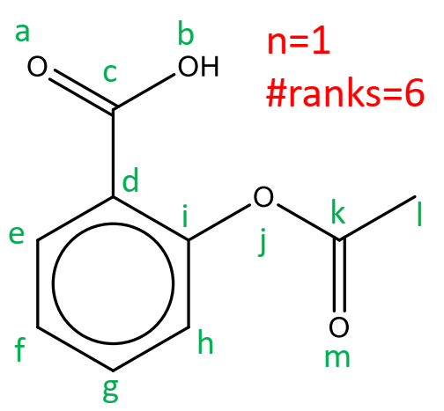
Cangen Example
Initial invariants encode atom type information

Slide 26
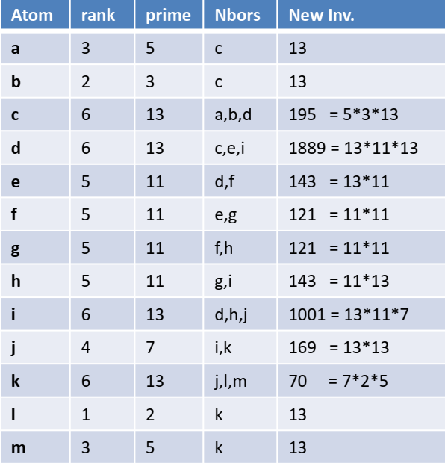
Cangen Example
Primes of neighbors are multiplied

Slide 27
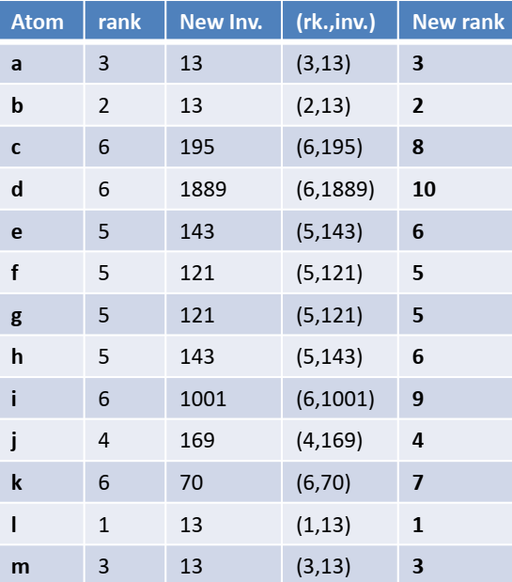
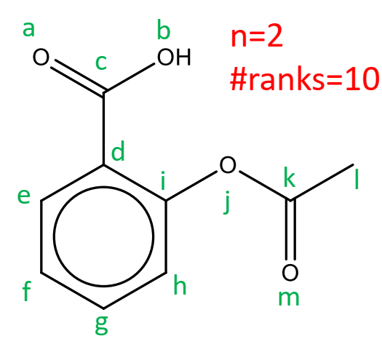
Cangen Example
Repeat until ranking is stable
Iteration 2

Slide 28
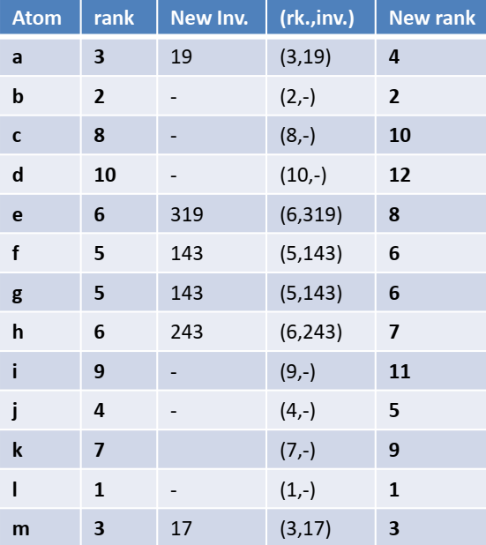
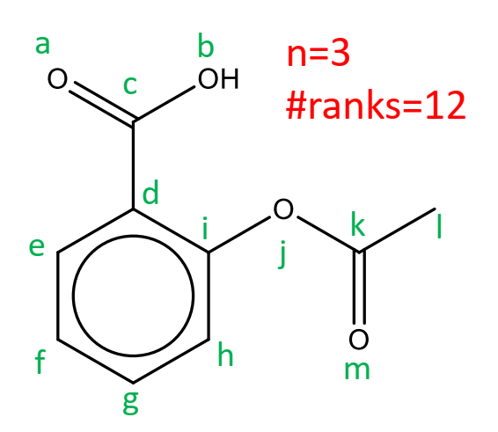
Cangen Example
Iteration 3

Slide 29
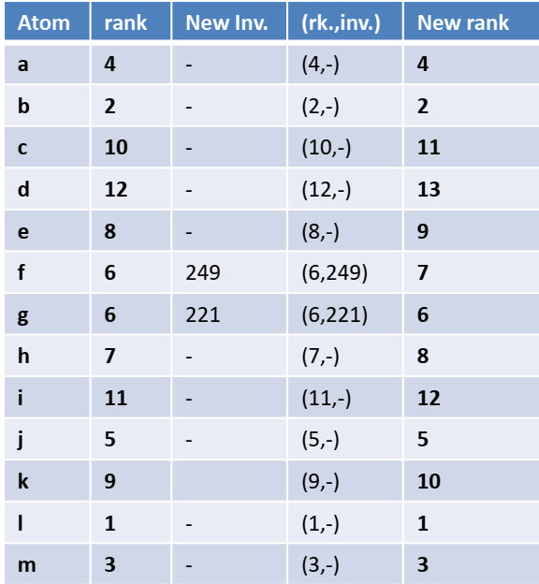
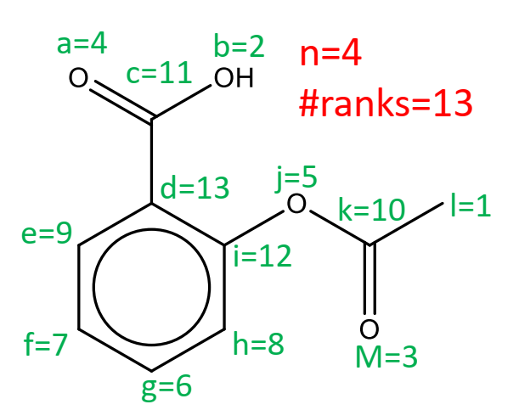
Cangen Example
Iteration 4 (Final ranking)

Slide 30
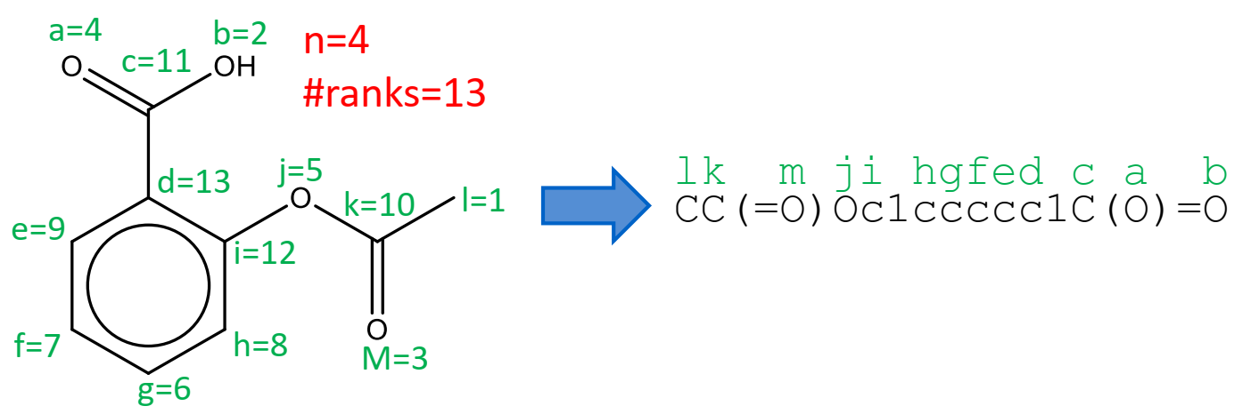
Cangen Example
Generating SMILES

Slide 31
Canonical Limitations
Depends on the aromaticity model
Different variations of the algorithms exist

Slide 32
Related Python Libraries
RDKit
pubchempy
py3Dmol

Slide 33
Related Websites
https://go.drugbank.com/
https://pubchem.ncbi.nlm.nih.gov/
https://chembl.gitbook.io/chembl-interface-documentation/downloads
https://drugs.ncats.io/
Online Tools:
Canonical SMILES generator:
https://www.antvaset.com/canonical-smiles-generator
SMILES checker:
https://www.cheminfo.org/flavor/malaria/Utilities/SMILES_generator___checker/index.html

Slide 34
Related Websites
Represented By: Afrooz Rashedi MSc student of AI Feel Free To Contact Me: afrooz.rashedi@gmail.com

